Slide 1


Case Study - 3: Cryptocurrency Trading
University of Niagara Falls Canada
Course: Spring 2025 Data Analytics Case Study- 3 (DAMO-611-3)
Professor: Cosimo Girolamo
Submitted by:
Rafael Ferreira Martins
Mansehaj singh Gill
Shilpa Shilpa
Anmol Jakhu
22nd June, 2025

Slide 2

Project Purpose & Scope
The cryptocurrency market's volatility poses significant challenges for short-term trading. Traditional models often lack prescriptive actions—specific Buy, Sell, or Hold recommendations with quantifiable confidence. This project addresses this by designing a model that forecasts market movements and generates actionable, confidence-based signals.
Traditional Models
Our Model
Indicate price movements
Forecasts market movements
Lack prescriptive actions
Generates actionable signals
Limited real-world usability
Incorporates market psychology

Slide 3
Defining Hypotheses
Hypothesis1 | Hypothesis2
H1: Portfolio Performance Hypothesis The model-guided trading strategy yields a statistically higher final portfolio value than random trading strategies. Null hypothesis (H₀): μ_model ≤ μ_random Alternative hypothesis (H₁): μ_model > μ_random (Where μ_model = mean portfolio value using the model, μ_random = mean portfolio value using random signals) | H2: Signal Return Hypothesis The distributions of future returns differ significantly across the Buy, Hold, and Sell signals generated by the model. Null Hypothesis (H₀): FRBuy =FRSell=FRHold (All signal types come from the same distribution of future returns.) Alternative Hypothesis (H₁): ∃ (i,j) : FRi≠FRj,for i≠j, i,j∈{Buy, Sell, Hold} (At least one pair of signal types has a statistically different return distribution.) Where RBuy, RSell,RHold​ be the distributions of future returns & FX​ denote the cumulative distribution function

Slide 4
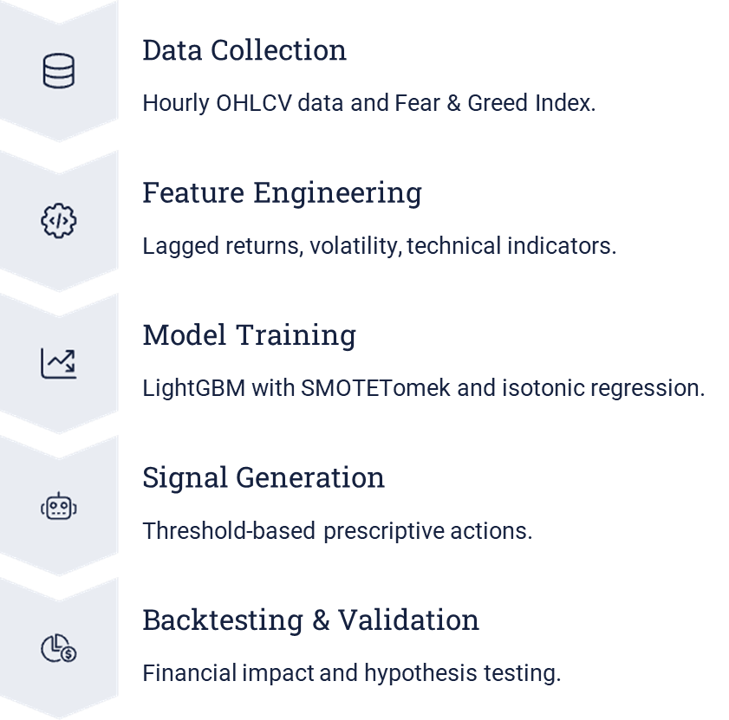
Project Phases & Data Collection
Project Phases
Data Sources
Binance API: Hourly OHLCV for BTCUSDT, ETHUSDT.
CoinGecko API: Daily market capitalization data.
Preprocessing
Resampled to 3-hour intervals.
Market cap aligned and merged.

Slide 5
Key Features & Data Understanding
Engineered Features
Key Observations
OHLC prices, volume, price change.
Bitcoin: Higher price, extreme volatility.
Rolling volatility, market cap, dominance.
Ethereum: Lower price, higher trading volume.
Lagged returns, technical indicators (RSI, MACD, Bollinger Bands).
BTC dominates market power.
Sentiment (Fear & Greed Index).

Slide 6
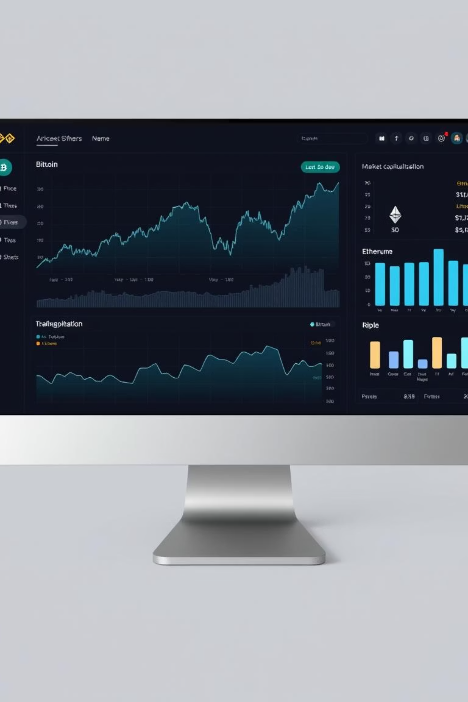
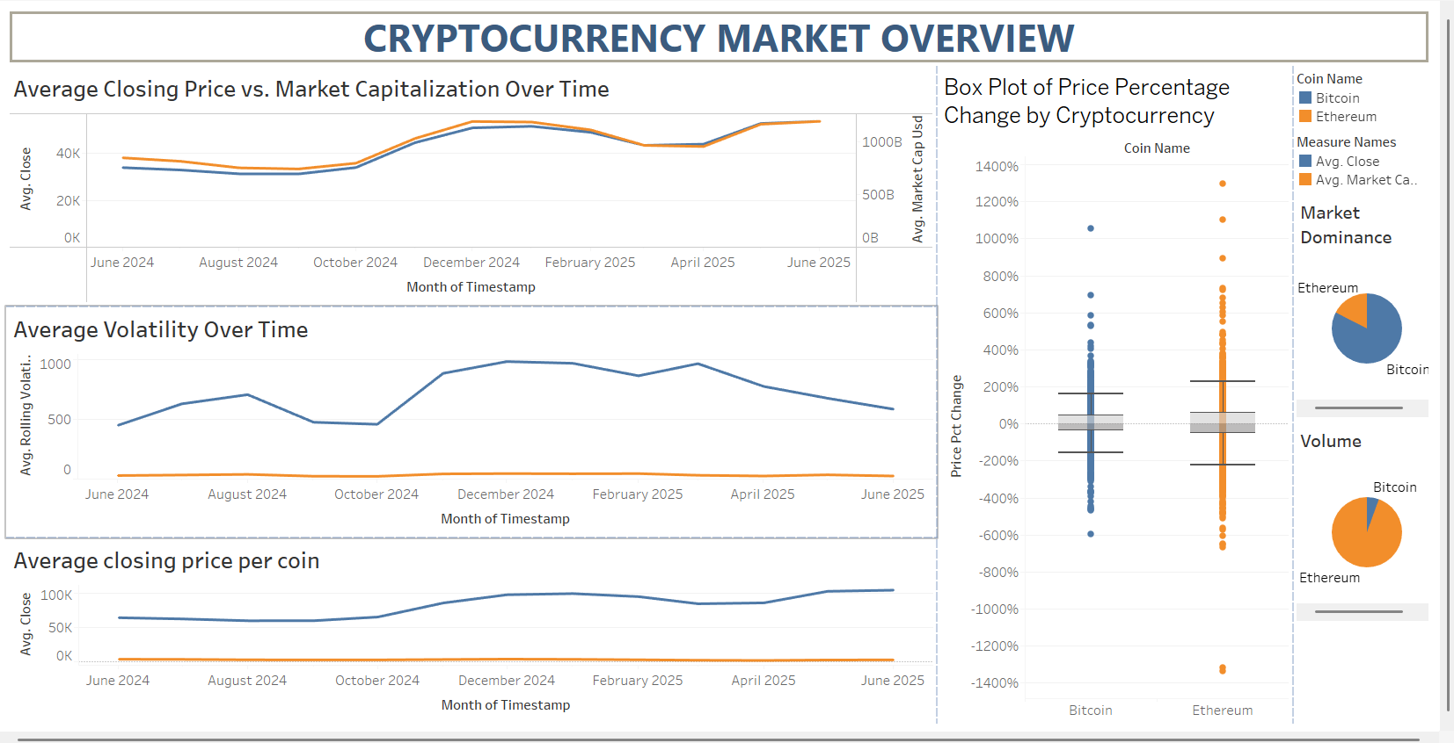



Data Visualization Insights
Hourly Price Trends
Frequent intraday swings, spikes, and corrections.
Volume & Dominance
ETH higher volume despite lower market cap.
Market Dominance
Bitcoin strong dominance (~75.5%), ETH stable below 25%.

Slide 7
Model Building: Prescriptive Classification
Model Approach
Target Variable
Identifies profitable Buy/Sell/Hold signals.
3-class target: Up (>0.3%), Down (<-0.3%), Stable (otherwise).
Combines feature engineering, imbalance correction.
Uses ensemble learning, probabilistic filtering.
Based on next 3-hour return.
Model Selection
LightGBMClassifier for efficiency.
Calibrated with isotonic regression.

Slide 8

Model Evaluation & Performance
80%
5.5x
3,301
Overall Accuracy
ROI
Total Trades
Robust precision-recall across classes.
Initial $10,000 to $55,919.15.
Executed in simulation.

Slide 9
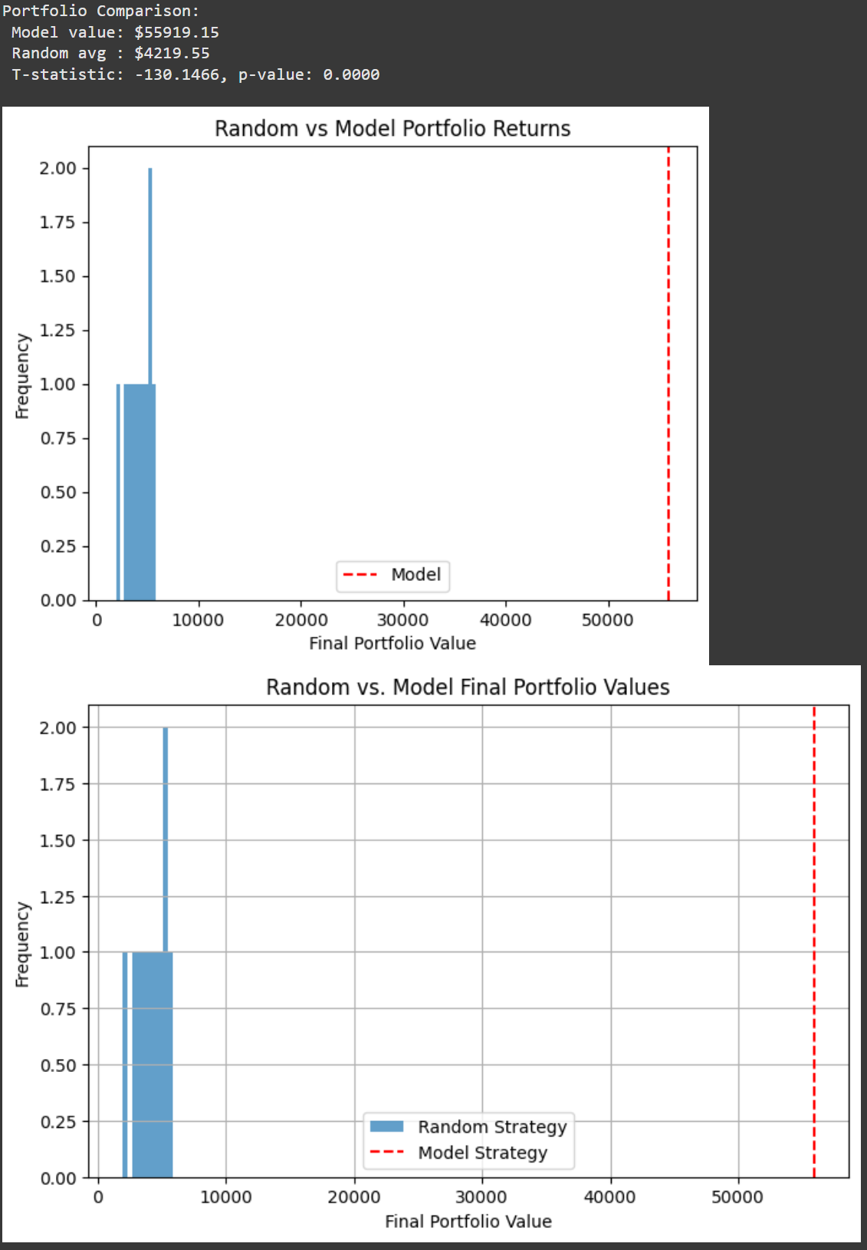
Hypothesis1 Validation(Model vs. Random Strategy )
Objective: Evaluate if the model yields higher returns than random signals.
Methodology Summary:
Backtested 1-year trading with LightGBM model signals (Buy/Sell/Hold)
Compared against 10 randomly generated strategies
Applied one-sample t-test for statistical validation
Key Metrics:
Model Final Value: $55,919
Random Avg Value: ~$4,220
T-statistic: -130.15
p-value: < 0.0001
Conclusion: Model significantly outperforms random trading — result is statistically significant

Slide 10
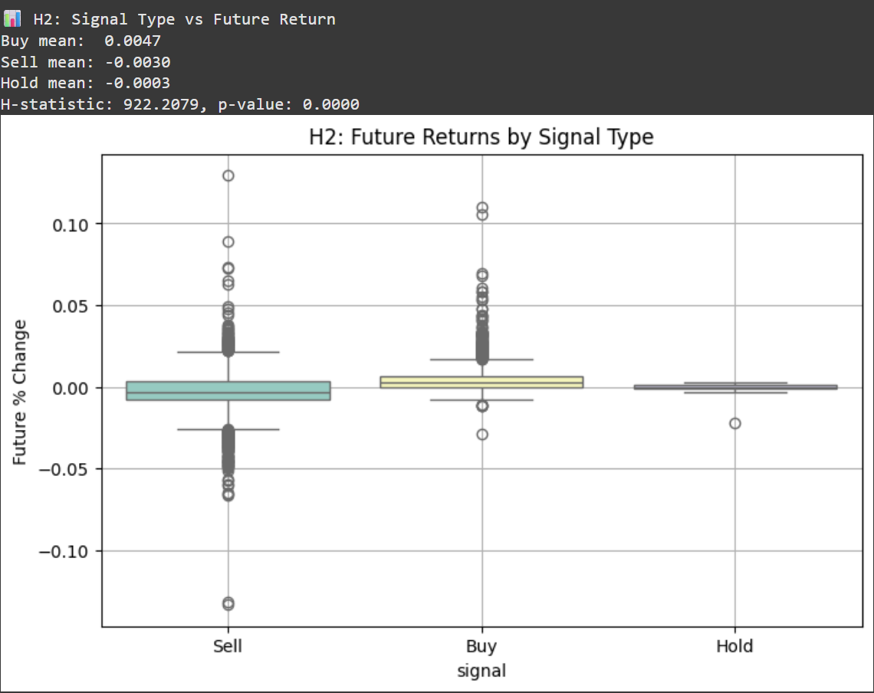
Hypothesis2 Validation(Signal Type vs. Future Returns)
Objective: Check if Buy, Sell, and Hold signals lead to different return outcomes.
Methodology Summary:
Analyzed future 3-hour returns based on model-issued signals
Applied Kruskal–Wallis H-test (non-parametric ANOVA)
Key Metrics:
Buy Mean Return: +0.0047
Sell Mean Return: -0.0030
Hold Mean Return: -0.0003
H-statistic: 922.21
p-value: < 0.0001 ✅
Conclusion: Return distributions differ significantly across signal types — confirms model’s signal validity

Slide 11

Business Impact & Future Enhancements
Key Strengths
Improvements
Next Steps
High accuracy, profitable, risk management, interpretability, automation.
Sentiment analysis, dynamic thresholds, regime detection, multi-asset expansion.
Live testing, expanded asset coverage for practical usability.

Slide 12

Thank You

